Slide 1
APPLIED PHYSICS LECTURE: 16
INSTRUCTOR:
Rizwan Fazal

Slide 2
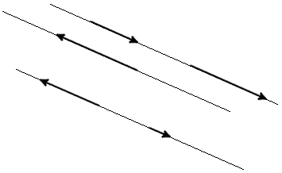
COLLINEAR VECTORS:
Vector parallel to one line or lying on one line are called collinear vectors (Fig. 1).

Slide 3
CONDITION OF VECTORS COLLINEARITY
Two vectors are collinear, if any of these conditions done:
Condition of vectors collinearity 1. Two vectors a and b are collinear if there exists a number n such that a = n · b

Slide 4
CONDITION OF VECTORS COLLINEARITY
Two vectors are collinear if relations of their coordinates are equal.

Slide 5
CONDITION OF VECTORS COLLINEARITY
Two vectors are collinear if their cross product is equal to the zero vector.

Slide 6
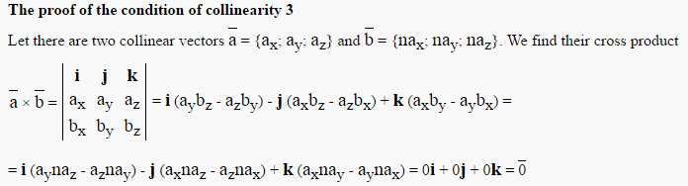
CONDITION OF VECTORS COLLINEARITY

Slide 7
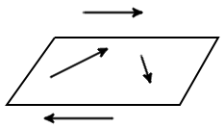
COPLANAR VECTORS:
Vectors parallel to the same plane, or lie on the same plane are called coplanar vector (Fig. 1).

Slide 8
CONDITION OF VECTORS COPLANARITY
The three vectors are coplanar if their scalar triple product is zero.
The three vectors are coplanar if they are linearly dependent.
Vectors are coplanar if among them no more than two linearly independent vectors.

Slide 9
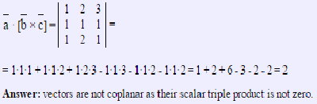
EXAMPLE 1:
Check whether the three vectors are coplanar a = {1; 2; 3}, b = {1; 1; 1}, c = {1; 2; 1}.Solution: calculate a scalar triple product of vectors

Slide 10


